Slide 1
Football league data Domain : Sports
Prudhvi RaJ
Business Operations ANALYST
M.S.International Inc

Slide 2
Introduction
Football League stats for four seasons.
FTHG: home team goals at end of match
FTAG: away team goals at end of match
FTR: match result
HST: home team shots on target
AST: away team shots on target
HC: home team corner kicks
AC: away team corner kicks

Slide 3
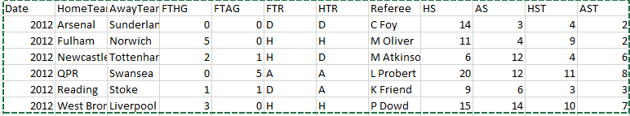
Sample DATA

Slide 4
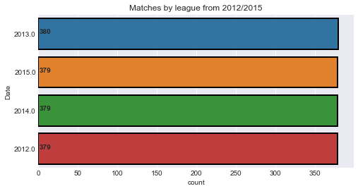
Q1 Matches by League

Slide 5
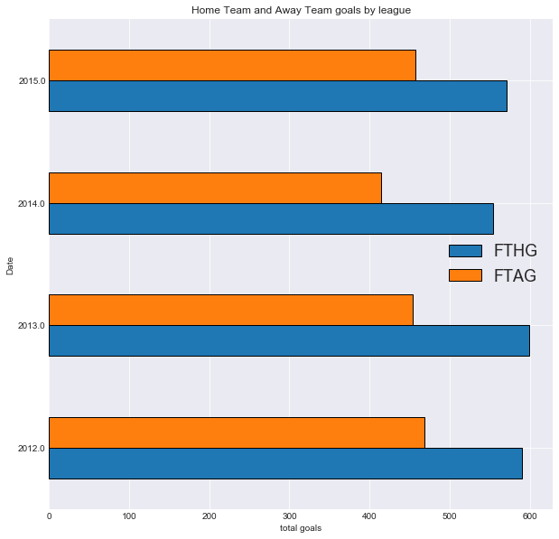
Q2 Comparison of home and away team goals
Home team goals are always more than away team in all the seasons.
FTHG>FTAG

Slide 6
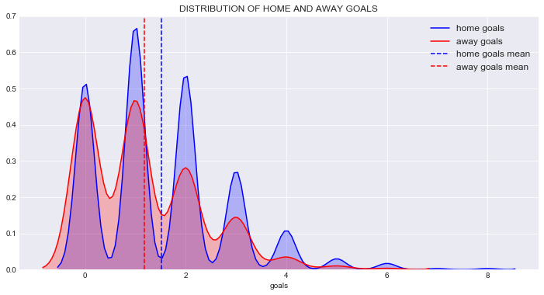
Q3 DistRibution Of Home and away goals by mean

Slide 7
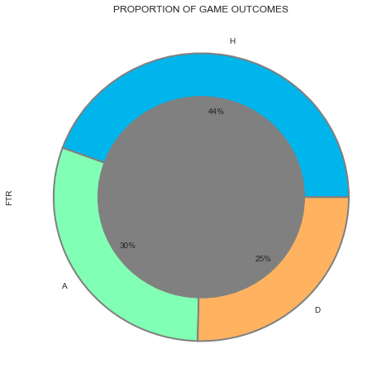
Q4 Proportion of game outcomes

Slide 8
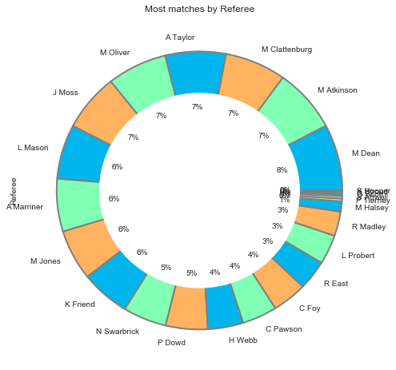
Q5 Most number of matches by Referee

Slide 9
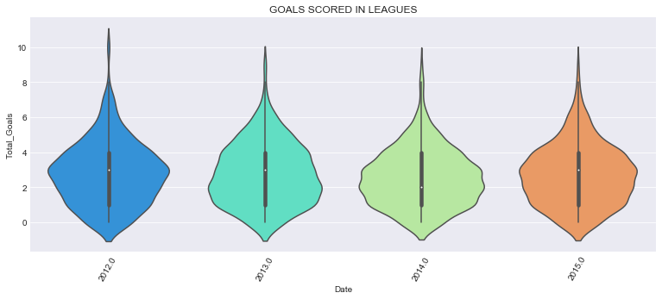
Q6 Goals scored in league

Slide 10
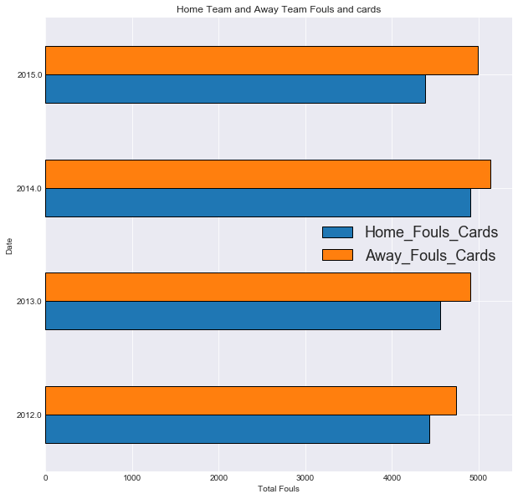
Q7 Home team and away team fouls , yellow and red cards

Slide 11
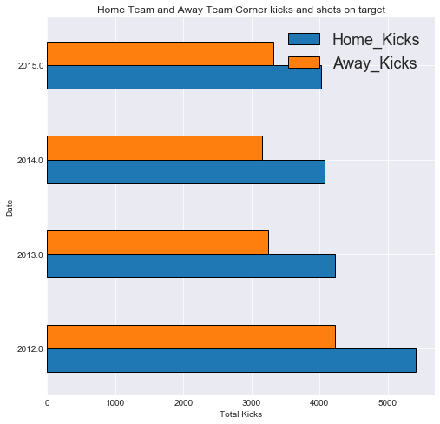
Q8 Home Kicks vs away kicks

Slide 12
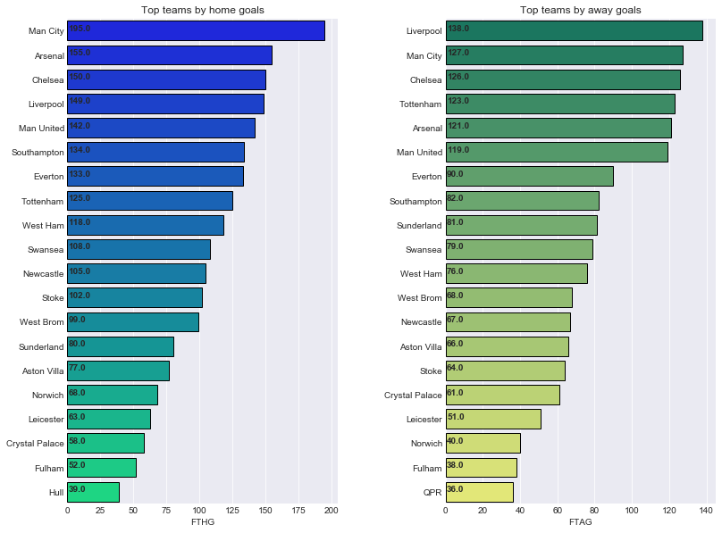
Q9 Best and worst teams

Slide 13

Conclusion

